Slide 1
Singular perturbation based nonlinear control strategies for complex systems
Sergio Esteban
sesteban@us.es
Department of Aerospace Engineering
University of Seville, Spain

Slide 2
Outline
Introduction.
Mathematical Model.
Singular Perturbation Formulation.
Control Strategy: Singular Perturbation Formulation.
Stability Analysis: Singular Perturbation Formulation.
Conclusions.
Open Research Lines

Slide 3
Motivation
Complex nonlinear systems:
  High maneuverability with inherent instability.
  Mathematical modeling complexity:
    High order dynamics
      Example: Rotatory parts ⇒ Increase complexity of models.
  Control problem difficult to approach due to nonlinearities.
High order dynamics systems:
  Present stiffness associated to small parasitic constants.
    small time constants, masses, resistances, inductances, capacitances, moments of inertia, Reynolds number…
  Source of increased order and stiffness
    produces multiple time-scale behavior: simultaneous occurrence of SLOW and FAST phenomena.

Slide 4
Proposed Solution
Strategy: Sequential Singular Perturbation (SP) Methodology
  Time Scale (TS) Analysis
  Control strategy
  Stability Analysis
  Mathematical upperbounds
Approach:
  Singular Perturbation (SP) Methods:
    Yields degenerated (singularly perturbed) systems: SLOW and FAST
      Model order reduction.
      The analysis has NO SIMPLIFICATIONS.
    Each system can be stabilized separately.
    Simplifies the burden associated to control design and stability analysis.

Slide 5
Singular Perturbation Solution
Define Singular Perturbation methodology that permits:
  Analyze time scale properties of singular perturbation problems.
  Provide appropriate control laws for SP 3-Time-Scale (3TS) systems.
    Select desired degree of stability of each of the time-scale subsystems.
  Define methodology that permits to demonstrate the asymptotic stability properties of the resulting closed loop full system:
    Select Lyapunov functions for each of the singularly perturbed systems.
    Construct associated composite Lyapunov function for the full system.
  Provide a general SP Analysis methodology for Nth-time-scale systems.
    Time scale analysis.
    Control strategy
    Asymptotic Stability.

Slide 6
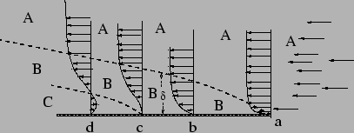
Singular Perturbation: Historical Perspective
Systems ⇒ interaction of slow and fast dynamic modes ⇒ suffer from the higher dimensionality and ill-conditioning.
The time-scale control strategies take advantage of these stiffness properties by decomposing the original ill-conditioned system into two subsystems with separate time scales:
  the reduced order (slow)
  the boundary layer (fast)
This time-scale approach is asymptotic
  exact in the limit as the ratio ε of the speeds of the slow versus the fast dynamics tends to zero.
Singular perturbation and time-scale methodologies widelly used in the literature:
  Traditional tool of fluid dynamics and nonlinear mechanics ⇒ Prandtl [Prandtl 1904]
Boundary layer definition:
  For high Reynolds numbers, the velocity in incompressible viscous flow past an object changes very rapidly at the boundary from zero to the value as given by the solution of the Navier-Stokes equation.

Slide 7
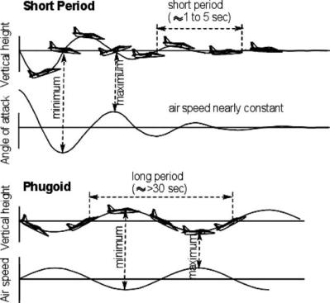
Singular Perturbation: Historical Perspective
Singular perturbation and time-scale methods have been applied to a wide range scientific branches [Naidu 2002]:
  from aerospace systems, to electrical systems and electronics, structures and mechanics, robotics, chemical reactors, soil mechanics, celestial mechanics, quantum mechanics, thermodynamics, thermoelasticity, elasticity, lubrication, vibrations, renewal processes, agricultural engineering, ecology, biology...
SP & TS are embedded naturally in aerospace systems:
  Phugoid and Short period mode in longitudinal aircraft dynamics.
First application of singular perturbation to aerospace systems:
  Solve complex flight optimization problems: late 1960s [Mehra 1979]
Widelly used in many aerospace applications in which SP & TS present:
  Reffer to the literature review [Naidu 2001]

Slide 8
Proposed Problems
Problem 1
  Underactuated Test Bench Problem
Problem 2
  Regulate the vertical displacement of a helicopter model on a platform ⇒ desired final altitude.
  Underactuated control signals:
    collective pitch angle
    blade angular velocity
Problem 3-4
  Control of UAV in the longitudinal plane (longitudinal dynamics):
    Control problem→ difficult to approach due to nonlinearities
    Under-actuated model:
      Elevator deflection - δe & Thrust deflection – δT
  Control of UAV in the vertical plane (lateral-directional dynamics):
    Control problem→ difficult to approach due to nonlinearities
    Under-actuated model:
      Rudder deflection - δr & Aileron deflection – δa

Slide 9
Underactuated Test Bench Problem

Slide 10
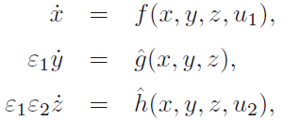
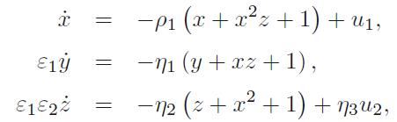
Underactuated System - I
Underactuated nature of the test Bench selected model
  Control signals are allocated only in two of the singularly perturbed subsystems
  The variable that it is desired to be regulated is the underactuated one: TD Control Strategy
Use of the simplified example to visualize the TD control strategy

Slide 11
Helicopter Mathematical Model

Slide 12
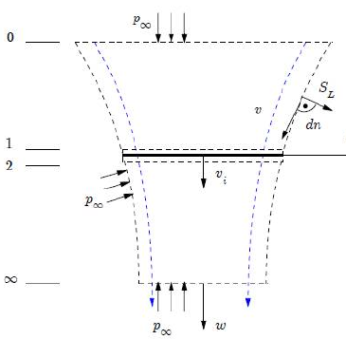
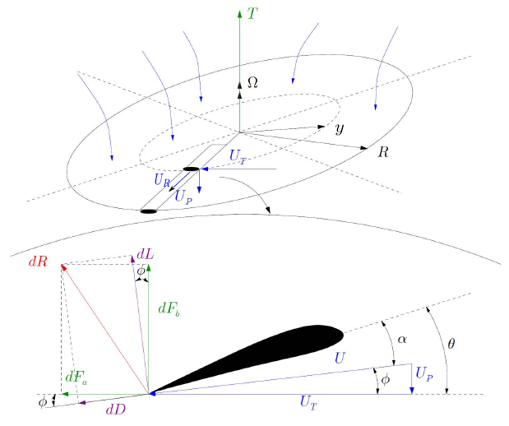
Derivation of the Mathematical Model
Helicopter Simplied vertical displacement model based on [Johnson 1994, Leishman 2006]:
  Momentum Theory (MT).
  Blade Element Theory (BET).
Proposed Thrust Coefficient (C_{T}) Models:
  Moment theory for uniform inflow in hover flight condition (MT_{H})
  Moment theory for uniform inflow in axial fliight condition (MT_{C})
  Combined blade element theory and momentum theory (BEMT)
  Combined blade element theory and momentum theory with Prandtls Tip-Loss Model (BEMT_{TL})
Selected closed-form solution for the thrust coecient model (C_{T}):
  Uniform inflow.
  Hover flight condition.
  Valid under premisses of v/vi0 < 2 [Johnson 1994]
Alternative C_{T} models:
  Willl be used as bench-mark ⇒ to validate the proposed control strategies

Slide 13


Selected Helicopter Mathematical Model - I
Moment theory for uniform inflow in hover flight condition MT_{H} [Johnson 1994, Leishman 2006, Pallet 1991]: 3 distinct dynamics
  Vertical Displacement Dynamics
  Engine and Rotational Dynamics
  Collective Pitch Dynamics
⇒ rotational speed of the rotor blades
⇒ height of helicopter above the ground
⇒ Collective pitch angle of the blades

Slide 14

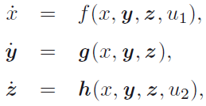
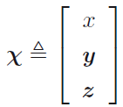


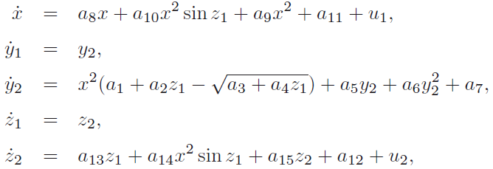


Selected Helicopter Mathematical Model - I
Moment theory for uniform inflow in hover flight condition (MT_{H}) in State Space Form:
  Vertical Displacement Dynamics
  Engine and Rotational Dynamics
  Collective Pitch Dynamics
Helicopter Dynamics

Slide 15
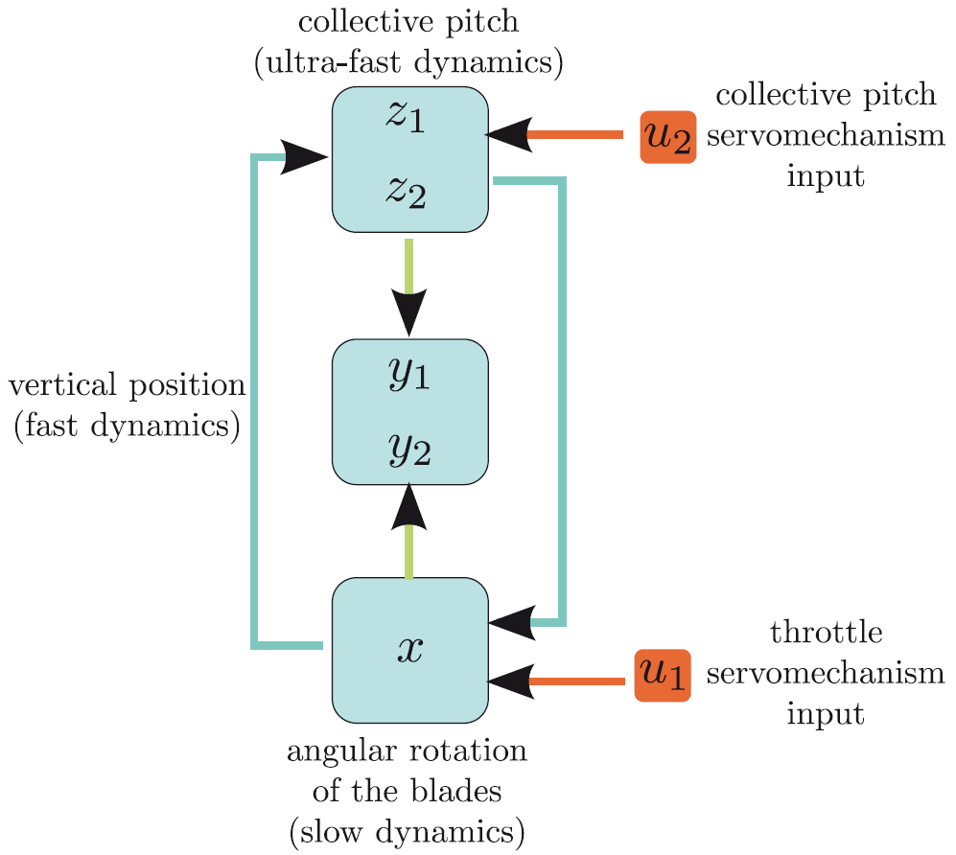
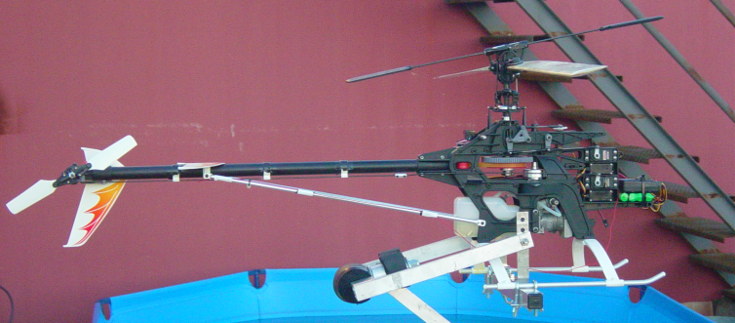
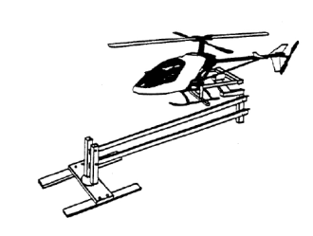
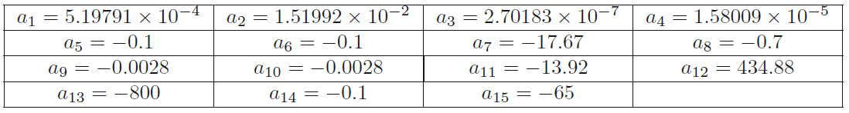
Selected Helicopter Mathematical Model - II
High degree of coupling

Slide 16


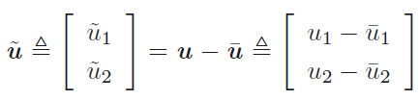






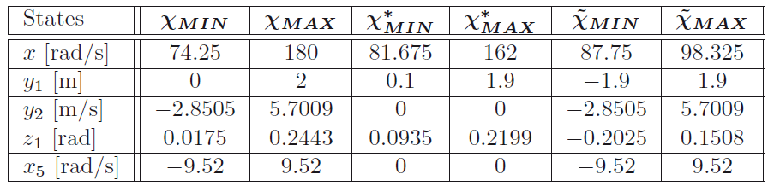
Selected Helicopter Mathematical Model - III
Error-Dynamic Vectors
Limit Error-Dynamic Vectors
Bounded Values for the Helicopter Variables

Slide 17
Singular Perturbation Control of the
Longitudinal and Lateral-Directional
Flight Dynamics of an UAV

Slide 19
Model Definition - I

Slide 20
Model Definition - II

Slide 21
Singular Perturbation Formulation

Slide 22
Outline: Singular Perturbation
Introduction to SP
Introduction to 2TS SP
Top-Down and Bottom Up Methodologies
Intuitive Description of 3TS Decomposition
TD & BU Extension for N^{th}-Time-Scale System
Time-Scale Selection:
  Simplified Example
  Helicopter Problem
  Longitudinal and Lateral-Directional Flight Dynamics

Slide 23
Introduction to Singular Perturbation - I
Singular perturbation techniques permit to deal with the complexity and nonlinearities present in many aerospace systems.
Methodology:
  Identify the existence of times-scale behaviors.
  Chose the appropriate Time-scale separation.
  Use the time-scale separation:
    Control strategies
    Stability analysis
SP & TS ⇒ allows to express the full problem as a composite description of the complex dynamics of each of the subsystems.
This time-scale decomposition permits:
  Understand the behavior of each of the resulting subsystems (when being analyzed with respect to their new time-scales).
    Difficult when trying to accomplish for the full system

Slide 24
Introduction to Singular Perturbation - II
Proposed SP & TS Step-by-Step
  Design proper control laws ⇒ with a desired degree of stability.
  Select appropriate composite Lyapunov function for the complete singularly perturbed system.
  Demonstrate asymptotic stability for the resulting closed-loop nonlinear SP system.
The time-scale analysis here presented is based in a extension from the general two-timescale singular perturbation formulation [Kokotovic 86]
  Two-Time-Scale Singularly Perturbed Systems (2TS SP)
Contribution: Top-Down (TD) and Bottom-Up (BU) methodologies:
  Analysis of Three-Time-Scale Singularly Perturbed Systems (3TS SP)
    Control strategy
    Stability analysis
  Provide a more general Nth-time-scale singular perturbation formulation

Slide 25

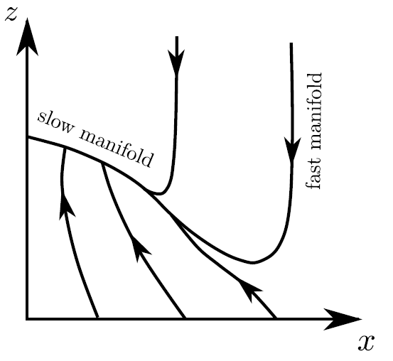

General 2-Time-Scale Systems
General 2TS SPS
Isolated equilibrium at the origin
⇒ Parasitic constant ⇒ defines the stretched time scale of the fast subsystem
are smooth to ensure that for specified initial conditions
has unique solution
Reduced Order Modelling ⇒ Singular Perturbation and Time-Scale Analysis
Setting the singular parameter ⇒
Reduced order (slow) system
Boundary layer (fast) system
⇒ Treated like a fix system in the boundary layer

Slide 26
Top-Down and Bottom-Up Time-Scale Analysis - I
Two different, and equivalent approaches that help to analyze the time-scale singularly perturbed systems.
The strategy consists on treating 3TS ⇒ 2 distinct 2TS SP problems
  using the standard two-time-scale analysis.
Each one of the two resulting 2TS SP sub-problems is considerably simplified:
  Obtain appropriate control laws that stabilize each of the resulting subsystems.
  Eases the complexity associated to guarantee the interconnection properties among the different time-scale subsystems.
Each of 2TS SP sub-problems consists of a slow and a fast subsystem,
  Selection of the appropriate control laws ensures that the associated subsystems are each asymptotically stable.
  Necessary to demonstrate the validity of the Boundary Layer that defines slow and fast systems.
Diversity: TD, or the BU methodologies,
  Permits the designer to select either methodology.

Slide 27

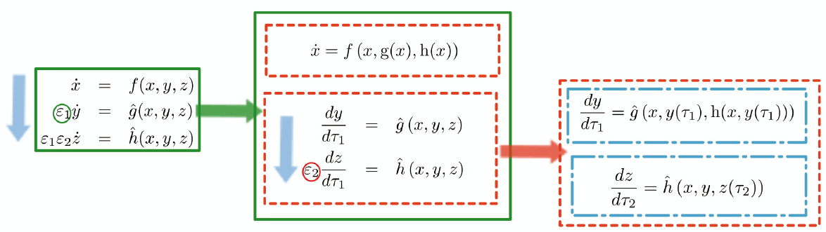
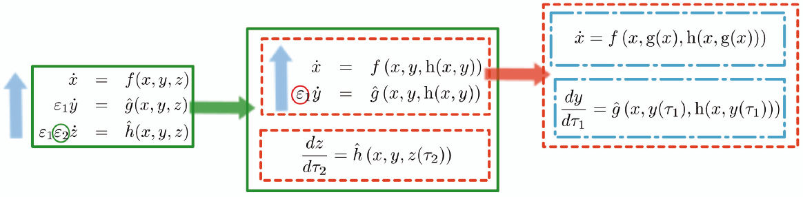

Top-Down and Bottom-Up Time-Scale Analysis – II

Slide 28
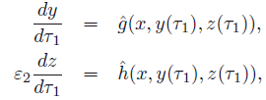





Top-Down Time-Scale Analysis - I
reduced (slow) subsystem
applying the stretched time scale
boundary layer (fast) subsystem
quasi-steady-state equilibria of the boundary layer
applying the stretched time scale
reduced (slow) subsystem
boundary layer (fast) subsystem
boundary layer (fast) subsystem
quasi-steadystate equilibria of the boundary layer

Slide 29
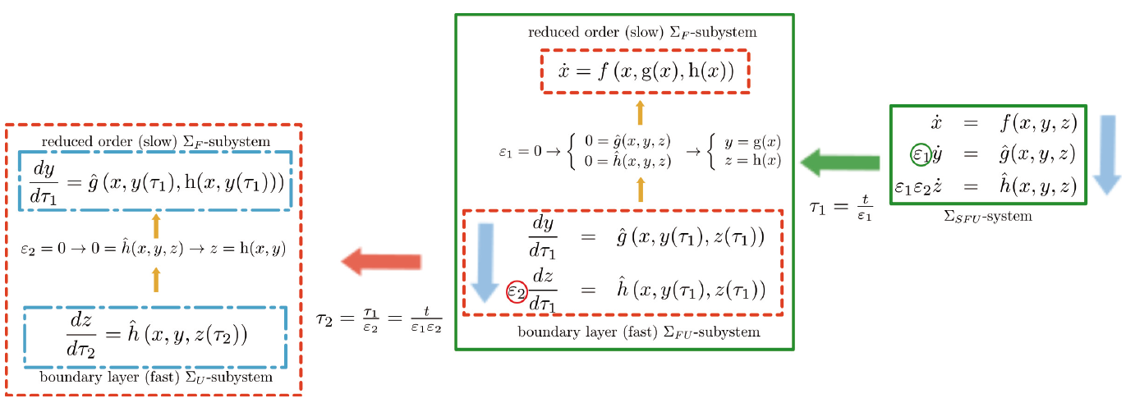
Top-Down Time-Scale Analysis - II

Slide 30




Bottom-Up Time-Scale Analysis - I
reduced (slow) subsystem
applying the stretched time scale
boundary layer (fast) subsystem
quasi-steady-state equilibria of the boundary layer
reduced (slow) subsystem
applying the stretched time scale
boundary layer (fast) subsystem
boundary layer (fast) subsystem
quasi-steadystate equilibria of the boundary layer
Equivalency between TD & BU: Interconnection properties

Slide 31
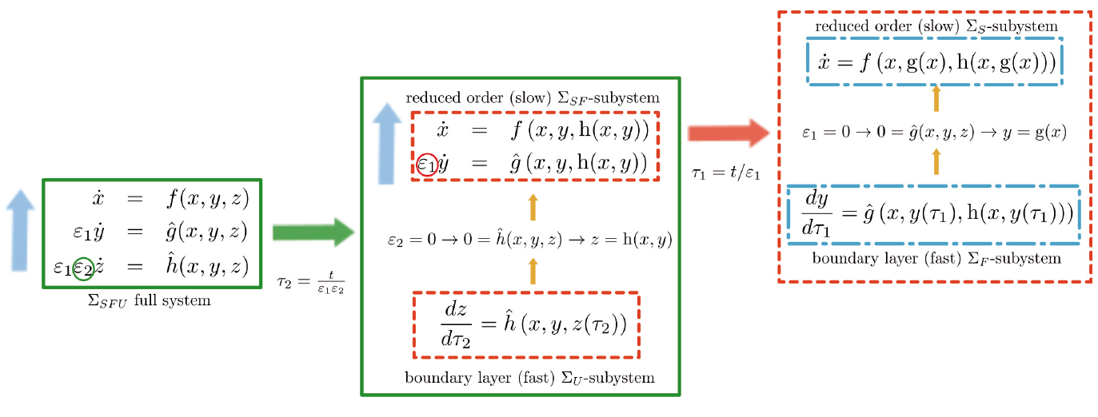
Bottom-Up Time-Scale Analysis - II

Slide 32
TD and BU Interconnection Properties - I
Equivalency between TD & BU: Interconnection properties:
  The reduced order Σ_{S}-subsystem of the TD analysis is also the slow movement of the Σ_{SF} –subsystem obtained in the BU analysis
  The Σ_{F} -subsystem is the slow movement of the Σ_{FU}-subsystem from the TD analysis and the fast movement of the Σ_{SF} -subsystem from the BU analysis, becoming the interconnected subsystem between both the TD and BU methodologies
  The Σ_{U}-subsystem is the fast movement of the Σ_{FU}-subsystem from the TD analysis, and also the boundary layer for the BU analysis, and the ultra-fast movement of Σ_{SFU}

Slide 33
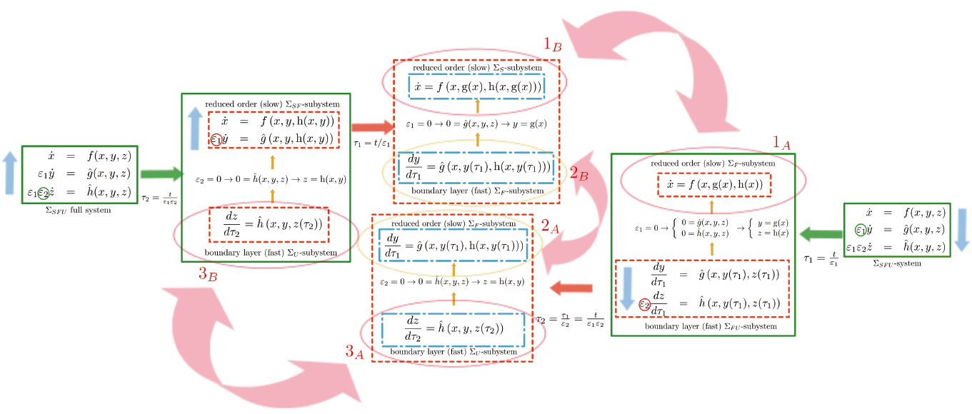
TD and BU Interconnection Properties - II

Slide 34
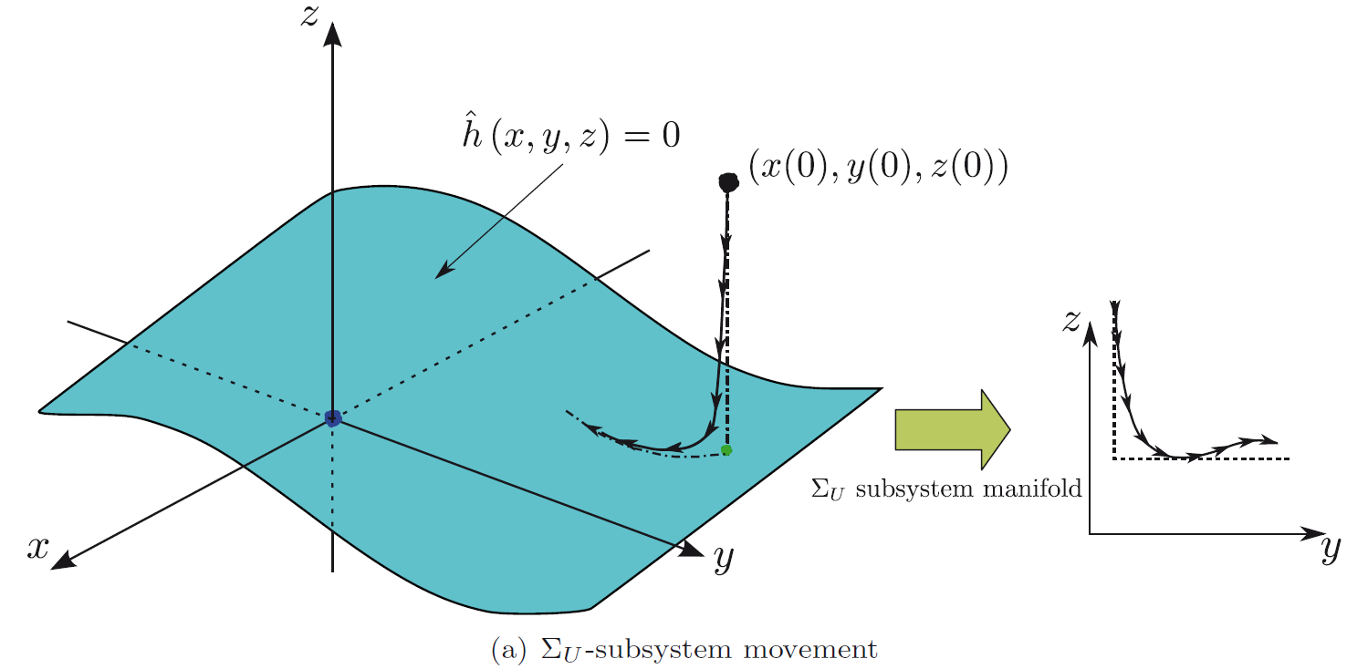
Intuitive Description of the Three-Time-Scale Decomposition - I
Natural evolution of a generic 3TS model: BU sequential TS analysis.
Evolution of the ultra-fast variable z as it moves through the configuration space of the boundary layer Σ_{U}-subsystem:
Σ_{U}-subsystem CONFIGURATION SPACE
z ⇒ surface quasi-steady-state equilibrium of the Σ_{U}-subsystem
    x and y behave as fixed parameters

Slide 35
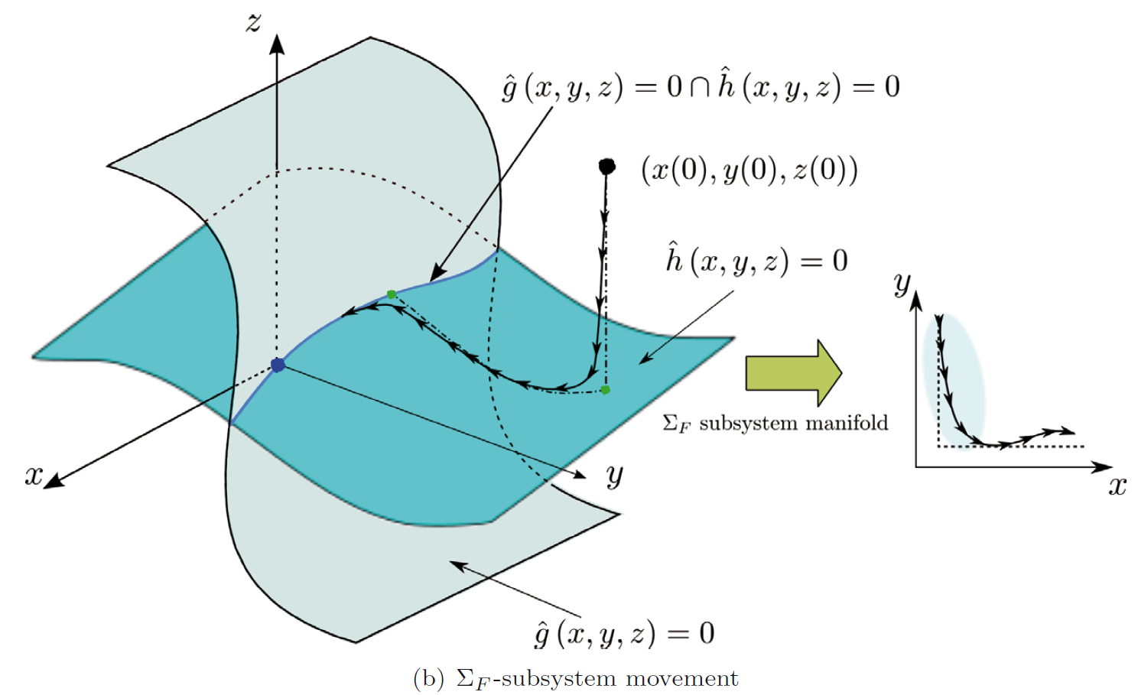
Intuitive Description of the Three-Time-Scale Decomposition - II
Evolution of the fast state variable y as it moves on the configuration space of the boundary layer of the Σ_{SF} –subsystem
Σ_{F}-subsystem CONFIGURATION SPACE
y ⇒ surface quasi-steady-state equilibrium of the Σ_{F}-subsystem
    slow variable x behaves as a fixed parameter
    z = h(x,y) evolves on its manifold

Slide 36
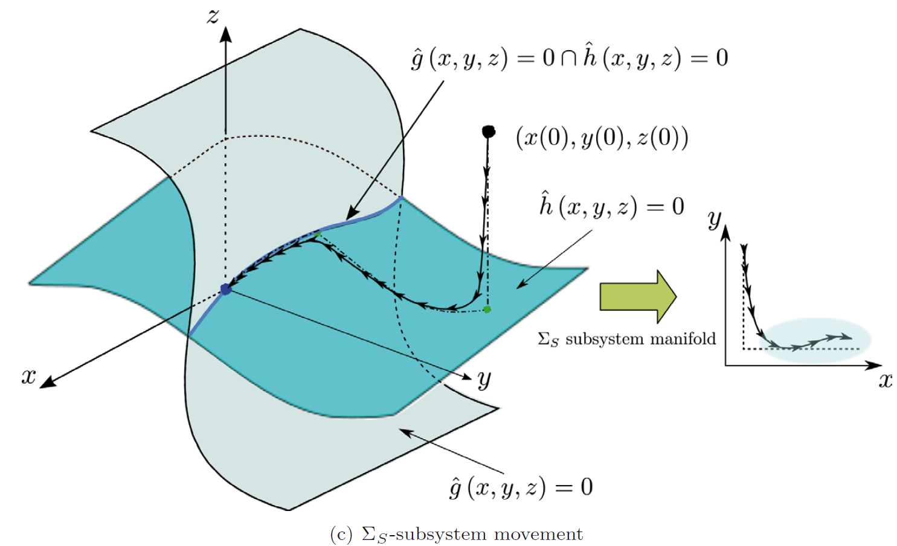
Intuitive Description of the Three-Time-Scale Decomposition - III
Evolution of the slow variable x as it moves in the manifold of the Σ_{S}-subsystem
Σ_{S}-subsystem CONFIGURATION SPACE
x ⇒ surface quasi-steady-state equilibrium of the Σ_{S}-subsystem

Slide 37
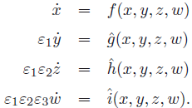
TD & BU Analysis Extension for Nth-Time-Scale System
TD & BU Time-scale analysis methodologies are applicable for a more general Nth-time-scale system
Provide an additional degree of freedom to the designer.
  After each subsystem reduction ⇒ time-scale decomposition using either TD or the BU depending on:
      the system structure of the resulting reduced order and boundary layer subsystems
      what suits better in order to proceed with the time-scale decomposition.
Example with a 4th-Time-Scale SP System

Slide 38
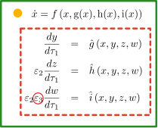



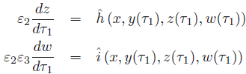

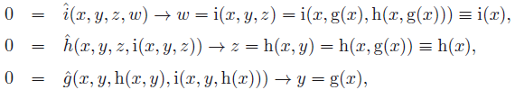
TD & BU Analysis Extension for 4th-Time-Scale System - I
Top-Down
reduced (slow)
applying the stretched time scale
boundary layer (fast)
quasi-steady-state equilibria of the boundary layer

Slide 39
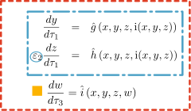


TD & BU Analysis Extension for 4th-Time-Scale System - II
Top-Down
Bottom-Up
applying the stretched time scale
reduced (slow)
boundary layer (fast) subsystem
boundary layer (fast)
quasi-steady-state equilibria of the boundary layer

Slide 40
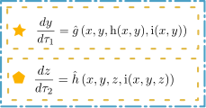



TD & BU Analysis Extension for 4th-Time-Scale System - III
Top-Down
Bottom-Up
Top-Down
applying the stretched time scale
reduced (slow)
boundary layer (fast) subsystem
boundary layer (fast)
quasi-steady-state equilibria of the boundary layer

Slide 41
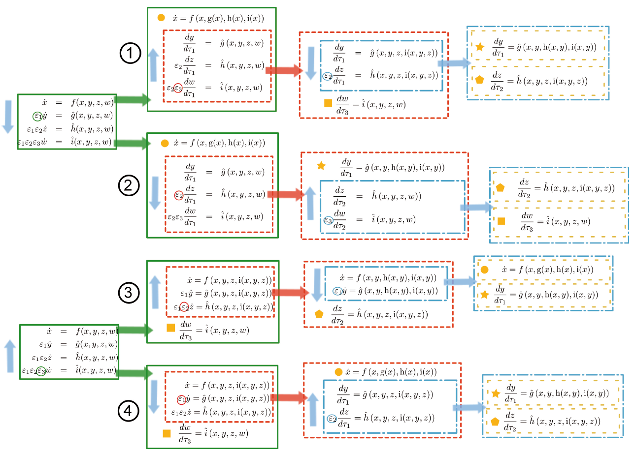
TD & BU Analysis Extension for 4th-Time-Scale System - IV
Equivalency bettween TD-BU Approaches

Slide 42
Time Scale Selection

Slide 43
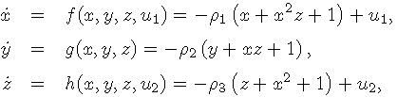
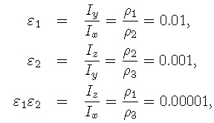
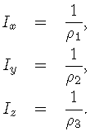

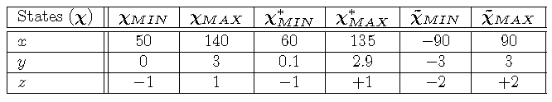
Time Scale Selection: Simplified Example
To ease the understanding of the proposed methods introduce simplified nonlinear example:

Slide 44
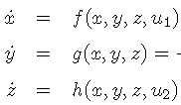



Time Scale Selection: Helicopter - I
SLOW
FAST
ULTRA-FAST
Identify Small Time Constants
higher order dynamics of the angular speed of the blades
Terms in
higher order dynamics of the vertical motion of the helicopter
Terms in
higher order dynamics of the collective pitch angle

Slide 45
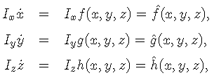
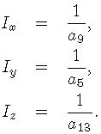

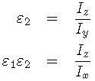



Time Scale Selection: Helicopter - II
  Slow dynamics:
    Angular velocity of the blades.
  Fast dynamics:
    Helicopter vertical motion
  Ultra-fast dynamics:
    Collective pitch angle.

Slide 46
Time Scale Selection – Long-Lat-Dir UAV I

Slide 47
Time Scale Selection – Long-Lat-Dir UAV II

Slide 48
Time Scale Sequential Decomposition

Slide 49
4-Time-Scale Sequential Decomposition: Longitudinal

Slide 50
4-Time-Scale Sequential Decomposition: Lat-Directional

Slide 51
4-Time-Scale Sequential Decomposition: Lat-Directional

Slide 52
4-Time-Scale Sequential Decomposition: Lat-Directional

Slide 53
4-Time-Scale Sequential Decomposition: Lat-Directional

Slide 54
4-Time-Scale Sequential Decomposition: Lat-Directional

Slide 55
4-Time-Scale Sequential Decomposition: Lat-Directional

Slide 56
4-Time-Scale Sequential Decomposition: Lat-Directional

Slide 57
4-Time-Scale Sequential Decomposition: Lat-Directional

Slide 58
4-Time-Scale Sequential Decomposition: Lat-Directional

Slide 59
4-Time-Scale Sequential Decomposition: Lat-Directional

Slide 60
4-Time-Scale Sequential Decomposition: Lat-Directional

Slide 61
4-Time-Scale Sequential Decomposition: Lat-Directional

Slide 62
Singular Perturbation Control Strategy
Break??

Slide 63
Outline Control Strategy
Underactuated Control Strategy:
  TD Control Strategy
    Simplified Example
  CFTD Control Strategy
    Simplified Example
Singular perturbation control strategies take advantage from the TD and the BU methodologies
  the control laws obtained by sequentially applying the selected methodology.
2 Control strategies are presented
  Top-Down Control Design (TD) ⇒ assumes fastest system ⇒ stable with desired response
  Composite Feedback Top-Down Control Design (CF-TD) ⇒ provides desired stability fastest system

Slide 64
Underactuated System - I
General TD & BU Control strategy is described in the thesis.
Underactuated nature of the dynamics of the selected helicopter model
  Control signals are allocated only in two of the singularly perturbed subsystems
  The variable that it is desired to be regulated is the underactuated one: TD Control Strategy
2 Control strategies are presented
  Top-Down Control Design (TD).
  Composite Feedback Top-Down Control Design (CF-TD).
Use of the simplified example to visualize the TD control strategy

Slide 65


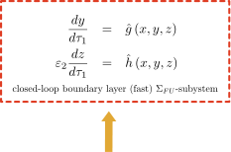
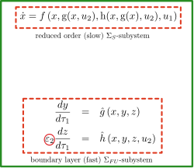

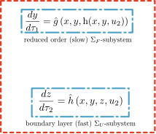




Estrategia de Control: TD
Dinámica Deseada
Variable Ultra-Rápida
¿Respuesta Deseada?

Slide 66






TD 3TS Control Strategy (Example - I)
1st Stage of the TD Control Design – u₂
reduced (slow) subsystem
boundary layer (fast) subsystem
quasi-steady-state equilibria of the boundary layer
reduced (slow)
boundary layer (fast)
quasi-steady-state equilibria of the boundary layer

Slide 67







TD 3TS Control Strategy (Example - II)
quasi-steady-state equilibria of the boundary layer
reduced (slow)
select control signal ⇒ target dynamics
desired value of
⇒ time constant that defines the desired dynamics for
Closed -loop

Slide 68




TD 3TS Control Strategy (Example - III)
2nd Stage of the TD Control Design – u₁
Closed loop boundary layer (fast) subsystem
reduced (slow)
boundary layer (fast)
quasi-steady-state equilibria
Substituting both quasi-steady-state equilibria
select control signal ⇒ target dynamics
desired value of
⇒ time constant that defines the desired dynamics for

Slide 69


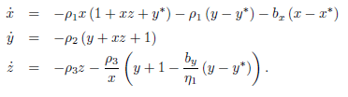


TD 3TS Control Strategy (Example - V)
Closed-Loop of the Simplified Model
CONTROL ⇒ Feedback Linearization
Control design parameter ⇒ transient response of the slow variable
Control design parameter ⇒ transient response of the fast variable
quasi-static equilibrium
Ultra-fast variable
Desired Response?

Slide 70






CF-TD 3TS Control Strategy
Solve the problem of selecting the response of the ultra-fast dynamics [Esteban, Balakrishnan, Gordillo & Aracil 2008]
Provide stability and desired response to the ultra-fast system :
  Decomposition of the control signal in fast and slow components.
Requirements that the fast component has to satisfy
  Closed loop systems have to behave like a SP system with a single equilibrium.
  The fast control signal must be deactivated in the reduced system.

Slide 71


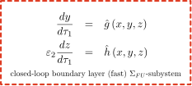

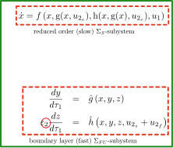


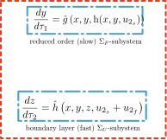




CF-TD 3TS Control Strategy
Desired Dynamics

Slide 72
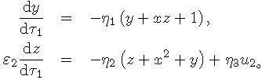
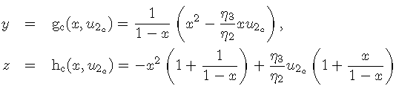
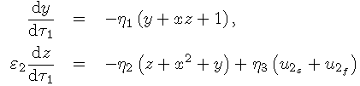
CF-TD 3TS Control Strategy (Example - I)
1st Stage of the CF-TD Control Design – u₂
reduced (slow) subsystem
boundary layer (fast) subsystem
quasi-steady-state equilibria of the boundary layer
slow and fast component

Slide 73







CF-TD 3TS Control Strategy (Example - II)
Requirements to be satisfied by the fast feedback
Closed-loop should remain a standard singularly perturbed system with unique equilibria
be inactive for
Time-Scale Decomposition
reduced (slow)
boundary layer (fast) subsystem
boundary layer (fast)
quasi-steady-state equilibria of the boundary layer

Slide 74






CF-TD 3TS Control Strategy (Example - IV)
Closed-loop
select control signal ⇒ target dynamics
⇒ time constant that defines the desired dynamics for
Resulting fast control law
Complete
Ultra-Fast Closed-Loop ⇒ equivalent to the TD Control Design
Satisfies 1st Requirement
2nd Stage of the CF-TD Control Design – u₁
EQUAL to 2nd Stage of the CF

Slide 75



CF-TD 3TS Control Strategy (Example - IV)
CONTROL ⇒ Feedback Linearization
b_{x} Control design parameter ⇒ transient response of the slow variable x
b_{y} Control design parameter ⇒ transient response of the fast variable y
b_{z} Control design parameter ⇒ transient response of the ultra-fast variable z
Quasi-static equilibrium
Desired Response
Ultra-Fast Variable

Slide 76

Results: Helicopter Control Simulations
Evaluate Performance of TD & CF-TD:
  Sensibility analysis performing 4 extreme distinctive maneuvers that include all possible helicopter maneuvers
  Descent flight with increasing engine RPM.
  Ascent flight with decreasing engine RPM.
  Ascent flight with increasing engine RPM.
  Descent flight with decreasing engine RPM.
Initial Conditions:
  y(0) = 1.85 m, y₁* = 0.5 m, x(0) = 120 rad/sec, & x* = 140 rad/sec
  y(0) = 0.5 m, y₁* = 1.0 m, x(0) = 140 rad/sec, & x* = 120 rad/sec.
  y(0) = 1.0 m, y₁* = 1.5 m, x(0) = 120 rad/sec, & x* = 170 rad/sec.
  y(0) = 1.5 m, y₁* = 0.75 m, x(0) = 170 rad/sec, & x* = 140 rad/sec

Slide 77




Helicopter TD Control Simulations - I

Slide 78




Helicopter TD Control Simulations - I

Slide 80
Control Strategy

Slide 81
Results - I

Slide 82
Results - II
State Following Reference

Slide 83
Results - III
Control Signals

Slide 84
Asymptotic Stability Analysis

Slide 85
Lyapunov Function Selection
Strategy to determine the necessary Lyapunov functions for each of the 3 subsystems ⇒ based in TD & BU Time Scale Analysis (TSA)
Sequential application of both TD & BU TSA:
  Singular Perturbation Time-sCale Analysis to determine the associated Lyapunov functions for
  Considering the selected target dynamics for each of the 3SP subsystem
  Solve the associated Lyapunov function for each system.
  Simplify the task of choosing Lyapunov functions
Simplified Example
  Lyapunov function candidate for the
  Lyapunov function candidate for the
  Lyapunov function candidate for the

Slide 86



Asymptotic Stability (Simplified Example) - I
Closed-loop System
Error Dynamics
desired values of the state variables

Slide 87

















Lyapunov Function Selection (Simplified Example)
  Lyapunov function candidate for the
  Lyapunov function candidate for the
  Lyapunov function candidate for the
Reduced order
solution of the associated Lyapunov function for the selected target dynamics
Reduced order
solution of the associated Lyapunov function for the selected target dynamics
Boundary layer
solution of the associated Lyapunov function for the selected target dynamics
Stability Parameters Selected by the designer

Slide 88











Asymptotic Stability 3TS - II
Phase 1
Stability analysis based on standard asymptotic stability requirements for 2 TS problems [Kokotovic 1986]
Extension for 3TS systems [Esteban, Aracil & Gordillo 2008]
  Divided in two Phases
Comply with the Growth Requirement of the System Σ_{SF}
Phase 2
Comply with the Growth Requirement of the System Σ_{SFU}

Slide 89



Σ_{SF} Asymptotic Stability 3TS - II
Asymptotic Stability Σ_{SF}
  Isolated equilibrium at the origin
  Reduced system conditions
  Boundary-layer system conditions
  Interconnection conditions
There exists a positive-definite an decrescent Lyapunov function candidate that satisfies the following inequality,
scalar function of vector arguments which vanishes only when its arguments are zero
Reduced System Conditions for the Σ_{SF}-subsystems Satisfied
Selected by
the designer

Slide 90



Σ_{SF} Asymptotic Stability 3TS - III
Asymptotic Stability Σ_{SF}
  Isolated equilibrium at the origin
  Reduced system conditions
  Boundary-layer system conditions
  Interconnection conditions
There exists a positive-definite an decrescent Lyapunov function candidate that satisfies
scalar function of vector arguments which vanishes only when its arguments are zero
Boundary-layer System Conditions for the Σ_{SF}-subsystems Satisfied
Selected by
the designer

Slide 91





Σ_{SF} Asymptotic Stability 3TS - IV
Asymptotic Stability Σ_{SF}
  Isolated equilibrium at the origin
  Reduced system conditions
  Boundary-layer system conditions
  1st Interconnection conditions
Determines the allowed growth of
First Interconnection Condition for the Σ_{SF}-subsystems Satisfied
Entire range admissible state values
Selected by
the designer

Slide 92






Σ_{SF} Asymptotic Stability 3TS - V
Asymptotic Stability Σ_{SF}
  Isolated equilibrium at the origin
  Reduced system conditions
  Boundary-layer system conditions
  2nd Interconnection conditions
Inequality can be written as ⇒
Inequality splitted in 2
Second Interconnection Condition for the Σ_{SF}-subsystems Satisfied

Slide 93







Asymptotic Stability 3TS – II 3TS Σ_{SF}
Satisfaction of the Asymptoric Stability Hypothesis
  Isolated equilibrium at the origin
  Reduced system conditions
  Boundary-layer system conditions
  Interconnection conditions
⇒ Growth Requirements satisfied
New Lyapunov function candidate
Stability ⇒ V₁ Positive Definite and Decreasing
Cotas Superiores ⇒
Theorem
Let inequalities be satisfied, then the origin is an asymptotically stable equilibrium
of the singularly perturbed system for all Σ_{SF} for all
Extended stability properties to SEMI-GLOBAL STABILITY
providing upper bounds of for the entire range of admissible state values &
extend domain of attraction to the entire range of admissible state values

Slide 94





Asymptotic Stability 3TS Σ_{SF} – Bounds Selection
Mathematical Upper level bounds are generated in a detailed and rigorous way.
How are the degrees of freedom selected ? ⇒ Q_{s} Q_{f}
Degree of Freedom
Allows you to select from the equations of upper bounds
⇒ Values ​​to satisfy the asymptotic stability properties of the complete systemo
Choice of the desired upper bounds having in mind
Produce the equations for the new desired upper bounds

Slide 95






Asymptotic Stability 3TS Σ_{SF} – Bounds Selection
Choice of values ​​to demonstrate System stability Σ_{SFU}
Relationship between Stability Parameters

Slide 96
PHASE 1
Comply with the Growth Requirement of the System Σ_{SF}
PHASE 2
Comply with the Growth Requirement of the System Σ_{SFU}

Slide 97





Asymptotic Stability 3TS Σ_{SFU}
Satisfaction of the Asymptoric Stability Hypothesis
  Isolated equilibrium at the origin
  Reduced system conditions
  Boundary-layer system conditions
  Interconnection conditions
⇒ Growth Requirement satisfied
New Lyapunov function candidate
Stability ⇒ V₂ Positive Definite and Decreasing
Upper Bounds ⇒
Theorem
Let inequalities be satisfied, then the origin is an asymptotically stable equilibrium
of the singularly perturbed system for all Σ_{SFU} for all

Slide 98




Asymptotic Stability 3TS Σ_{SFU} – Upper Bounds - I
Equations to define the desired upper bounds
Similarly
Q_{s} Q_{f} Q_{u} ⇒ degrees of freedom that we have determine the stability characteristics

Slide 99





Asymptotic Stability 3TS Σ_{SFU} – Upper Bounds - II
Choice of Stability Parameters Q_{s} ,Q_{f} y Q_{u}
Stability analysis ⇒ EXACT MATHEMATICAL EXPRESSION ARE OBTAINED ⇒ Q_{s} ,Q_{f} y Q_{u}
⇒ Values ​​to satisfy the asymptotic stability properties of the complete system
⇒ Parameter of Arbitrary Stability ⇒ CHOOSEN DEGREE OF FREEDOM
SELECTION OF DESIRED UPPER BOUNDS

Slide 100




Σ_{SFU} Asymptotic Stability: Bounds - III

Slide 101





Σ_{SFU} Asymptotic Stability: Bounds - V
Selection of stability parameters
Selection of desired upper bounds recalling that

Slide 102


Σ_{SFU} Asymptotic Stability: Bounds - VI
Stability Parameters Selected by the designer
Theorem
Let inequalities be satisfied, then the origin is an asymptotically stable equilibrium
of the singularly perturbed system for all
Extended stability properties to SEMI-GLOBAL STABILITY
providing upper bounds of for the entire range of admissible state values &
extend domain of attraction to the same range of admissible state values

Slide 103
TD & BU Stability Analysis Extension for Nth-Time-Scale System
Same presented stability time-scale analysis methodologies are applicable for a more general Nth-time-scale system
Provide an additional degree of freedom to the designer.
  After each subsystem reduction ⇒ time-scale decomposition using either TD or the BU depending on:
      the system structure of the resulting reduced order and boundary layer subsystems
      what suits better in order to proceed with the time-scale decomposition.
Example with a 4th-Time-Scale SP System

Slide 104
TD & BU Stability Analysis Extension for 4th-Time-Scale System
Equivalency bettween TD-BU Approaches

Slide 105
Conclusions
Proposed and proved a TD & BU methodology to analyze the asymptotical stability properties of a 3TS SP systems.
  Design proper control laws with a desired degree of response
    Degenerated systems can be stabilized separately simplifying considerably the control design
  Provides a methodology to obtain a Lyapunov function candidate for the entire system
    Using a weighted sum of the proposed Lyapunov function candidates of the 3TS subsystems
  Demostrate stablity of the closed-loop system
The validity of the methodology has been proved by:
  Obtaining stability upper bound limits on both boundary layers
  Satisfying that the selected parasitic constants for the control law proposed
TD & BU Time-scale analysis methodologies are extended for a more general Nth-time-scale system
  Provide an additional degree of freedom to the designer.
Sensitivity allows has been conducted on the proposed control laws under unmodeled dynamics using the presented alternative test bench C_{T} models.

Slide 106
Open Problems
Theoretical line: focused on the asymptotic stability analysis :
  Comprehensive study of how the upper bounds on the parasitic parameters are affected by the variation of the Fixed Parameters.
    Model Based
    Control design parameters
  Apply the same control strategy to different models
  Extension of the asymptotic stability properties at the origin and the semiglobal stability to exponential stability.
  Actuator saturations.
  Study Robustness SP for disturbance rejection
  Estudy different control solutions:
    Optimal control:
    SDRE
    …

Slide 107

muito obrigado…
perguntas?…

Slide 108
Bibliography - I
[Abed 1985] Stability of multiparameter singular perturbation problems with parameters bounds, in time varying systems with cone-restricted perturbations. Technical Report TR-85-5, Department of Electrical Engineering and Systems Research Center, University of Maryland, College Park, 1985.
[Ardema 1976] M.D. Ardema. Solution of the minimum time-to-climb problem by matched asymptotic expansions. AIAA Journal, 14:843–850, 1976.
[Etkin 1982] B. Etkin and L.D. Reid. Dynamics of flight: stability and control.
[Johnson 1994] W. Johnson. Helicopter Theory. Dover Pubns, 1994.
[Kelley 1971] H.J. Kelley. Flight path optimization with multiple time scales. Journal of Aircraft, 8:238–240,1971.
[Khalil 1987] H.K. Khalil Stability analysis of nonlinear multiparameter singularly perturbed systems. IEEE Transactions on Automatic Control, (3):260–263, 1987.
[Oh & Khalil 1997] S. Oh and H.K. Khalil. Nonlinear Output-Feedback Tracking Using High-gain Observer and Variable Structure Control. Automatica, 33(10):1845–1856, 1997.
[Kokotovic & O’Reilly 1986] P.V. Kokotovic, J. O’Reilly, and H.K. Khalil. Singular Perturbation Methods in Control: Analysis and Design. Academic Press, Inc., Orlando, FL, USA, 1986.
[Kokotovic et al 1987] P.V. Kokotovic, A. Bensoussan, and G. Blankenship. Singular perturbations and asymptotic analysis in control systems. Number 90. Springer-Verlag Berlin, 1987.
[Leishman 2006] J.G. Leishman. Principles of helicopter aerodynamics. Cambridge University Press, 2006.
[López & Valenzuela 2010] O. López and A. Valenzuela. Temario Helicópteros, volume Astronáutica y Aeronaves Diversas of Asignaturas en la Red 2009-2010. Universidad de Sevilla - Enseñanza Virtual, 2010.
[Mehra 1979] R. Mehra, R.Washburn, S. Sajan, and J. Carrol. A study of the application of singular perturbation theory. NASA CR-3167, 1979.
[Naidu 2001] D.S. Naidu and A.J. Calise. Singular perturbations and time scales in guidance and control of aerospace systems: A survey. Journal of Guidance, Control and Dynamics, 24(6):1057–1078, 2001.
[Naidu 2002] D.S. Naidu. Singular perturbations and time scales in control theory and applications: an overview. Dynamics of Continuous Discrete and Impulsive Systems Series B, 9:233–278, 2002.
[Pallet 1991] T.J. Pallet and S. Ahmad. Real-time helicopter flight control: Modelling and control. Technical Report TR-EE 91-35, 1991.
[Prandtl 1904] L. Prandtl. Uber Flussigkeits bewegung bei sehr kleiner Reibung, Verhaldlg III Int. Math. Kong.(Heidelberg: Teubner), pages 484–491, 1904.

